Slide 1
Week-10
COSC 32001 Computer Vision
Noopa Jagadeesh
Date: 21 March 2024

Slide 2
Recap
Image Gradients
Corner Detection
Optical Character Recognition(OCR)
Simple Shape Detection
Face detection and Blurring

Slide 3
Agenda
Student demo: Assignment#3
Cascade classifiers from OpenCV
Face Recognition
Feature Detection
Feature Matching
Image Similarity

Slide 4

Critical Path

Slide 5
Cascade classifiers from OpenCV
https://docs.opencv.org/3.4/db/d28/tutorial_cascade_classifier.html
Notes:
hydranet

Slide 6
OpenCV Haar Cascades
First published by Paul Viola and Michael Jones in their 2001 paper, ‘Rapid Object Detection using a Boosted Cascade of Simple Features’, this original work has become one of the most cited papers in computer vision literature.
In their paper, Viola and Jones propose an algorithm that is capable of detecting objects in images, regardless of their location and scale in an image. Furthermore, this algorithm can run in real-time, making it possible to detect objects in video streams.
Specifically, Viola and Jones focus on detecting faces in images. Still, the framework can be used to train detectors for arbitrary “objects,” such as cars, buildings, kitchen utensils, fruits etc.
Haar cascade classifiers based on features are a machine-based learning method in which both positive and negative photos learn a cascade function. It’s then used to classify items in other pictures.
Many algorithms are more accurate than Haar cascades ( SSDs, Faster R-CNN, YOLO, to name a few), but they are still relevant and useful today.
One of the primary benefits of Haar cascades is that they are just so fast — it’s hard to beat their speed. The downside to Haar cascades is that they tend to be prone to false-positive detections.

Slide 7
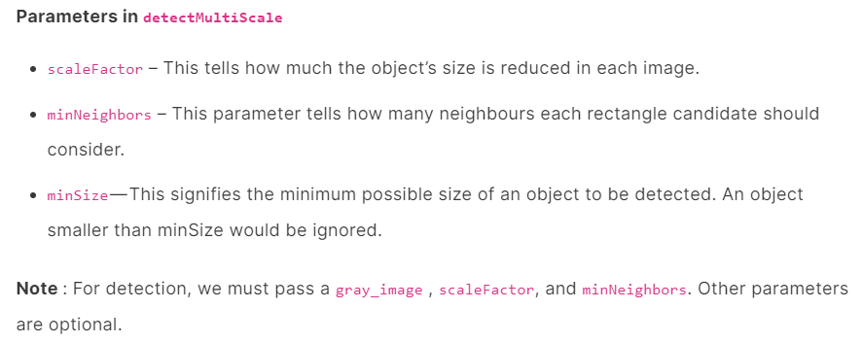
OpenCV Haar Cascades
The OpenCV library maintains a repository of pre-trained Haar cascades. Most of these Haar cascades are used for either:
https://github.com/opencv/opencv/tree/master/data/haarcascades
Face detection
Eye detection
Mouth detection
Full/partial body detection
Other pre-trained Haar cascades are provided, including one for Russian license plates and another for cat face detection.

Slide 8
Face Recognition

Slide 9

Face Recognition
With face recognition, we not only identify the person by drawing a BB on the face but we also recognise the person. With OpenCV and Python, through a database, we compare the person’s photo and we know how to identify it precisely.

Slide 10
Feature Detection
https://docs.opencv.org/3.4/df/d54/tutorial_py_features_meaning.html

Slide 11
Feature Detection
What is a feature?
When you see a mango image, how can you identify it as a mango?
By analyzing the color, shape, and texture you can say that it is a mango.
The clues which are used to identify or recognize an image are called features of an image.
In the world of computer vision and image processing, the ability to extract meaningful features from images is important. These features serve as vital inputs for various downstream tasks, such as object detection and classification. There are multiple ways to find these features.
In OpenCV, there are many routines to help us extract features from an image. We have previously used OpenCV can help find some high-level features.
Canny Edge Detection in OpenCV
Harris Corner Detection in OpenCV

Slide 12
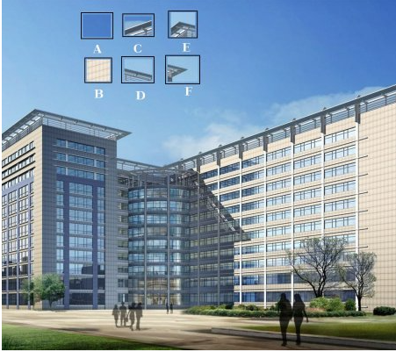
Feature Detection
At the top of image, six small image patches are given. Question is to find the exact location of these patches in the original image. How many correct results can you find?

Slide 13
Feature Detection
A and B are flat surfaces and they are spread over a lot of area. It is difficult to find the exact location of these patches.
C and D are much more simple. They are edges of the building. We can find an approximate location, but exact location is still difficult. This is because the pattern is same everywhere along the edge. At the edge, however, it is different. An edge is therefore better feature compared to flat area, but not good enough (It is good in jigsaw puzzle for comparing continuity of edges).
Finally, E and F are some corners of the building. And they can be easily found. Because at the corners, wherever you move this patch, it will look different. So they can be considered as good features.

Slide 14
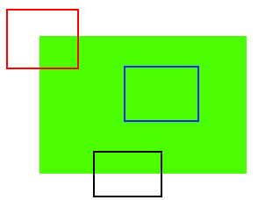
Feature Detection
The blue patch is flat area and difficult to find and track. Wherever you move the blue patch it looks the same.
The black patch has an edge. If you move it in vertical direction (i.e. along the gradient) it changes. Moved along the edge (parallel to edge), it looks the same.
And for red patch, it is a corner. Wherever you move the patch, it looks different, means it is unique. So basically, corners are considered to be good features in an image. (Not just corners, in some cases blobs are considered good features).
So now we answered our question, "what are features?". But next question arises. How do we find them? Or how do we find the corners?. We answered that in an intuitive way, i.e., look for the regions in images which have maximum variation when moved (by a small amount) in all regions around it. So finding these image features is called Feature Detection.

Slide 15
Feature Detection
We found the features in the images. Once we have found it, we should be able to find the same in the other images. How is this done? We take a region around the feature, we explain it in our own words, like "upper part is blue sky, lower part is region from a building, on that building there is glass etc" and we search for the same area in the other images. Basically, we are describing the feature. Similarly, a computer also should describe the region around the feature so that it can find it in other images. So called description is called Feature Description. Once we have the features and its description, we can find same features in all images and align them, stitch them together or do whatever you want.
We have different algorithms in OpenCV to find features, describe them, match them etc.

Slide 16
Feature Detection
Image feature extraction involves identifying and representing distinctive structures within an image. Reading the pixels of an image is certainly one. But this is a low-level feature. A high-level feature of an image can be anything from edges, corners, or even more complex textures and shapes.
Features are characteristics of an image. With these unique characteristics, you may be able to distinguish one image from another. This is the first step in computer vision. By extracting these features, you can create representations that are more compact and meaningful than merely the pixels of the image. It helps further analysis and processing.
Canny Edge Detection and Harris Corner Detection are two basic but very common feature extraction algorithms. Both of them return a pixel-based classification in the format of numpy arrays.

Slide 17
Feature Detection
Canny Edge Detection in OpenCV
Finding lines in an image is probably the simplest feature extraction. Its goal is to identify which pixel is on an edge. An edge is defined as a gradient on the pixel intensity. In other words, if there is an abrupt color change, it is considered an edge.
The argument to the cv2.Canny() function takes two numerical values, for minimum and maximum thresholds respectively. They are used in the hysteresis thresholding to consolidate pixels into edges. The higher the maximum, only the stronger edges are kept in the result. The higher the minimum, however, you will see more “disconnected edges” returned.
This function returns an numpy array that matched the pixel dimension of the image, which the value is either 0 (not on an edge) or 255 (on an edge).

Slide 18
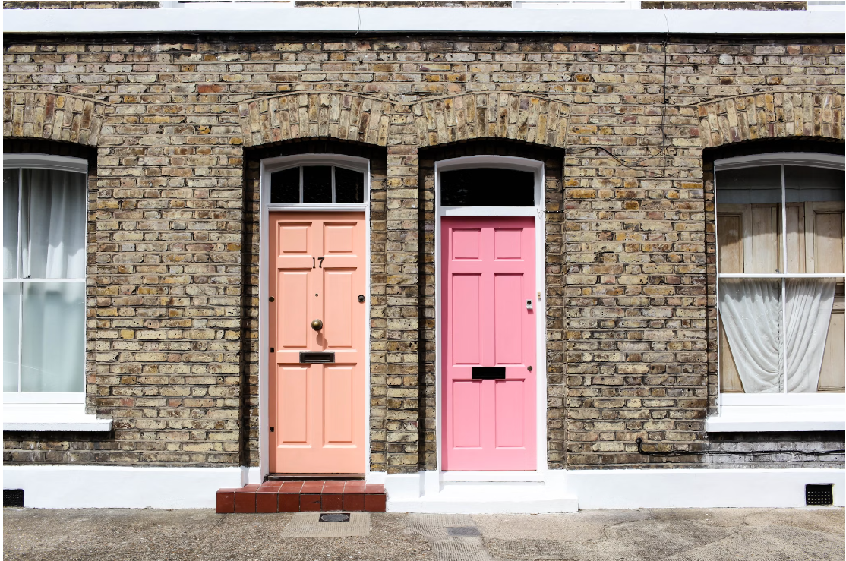
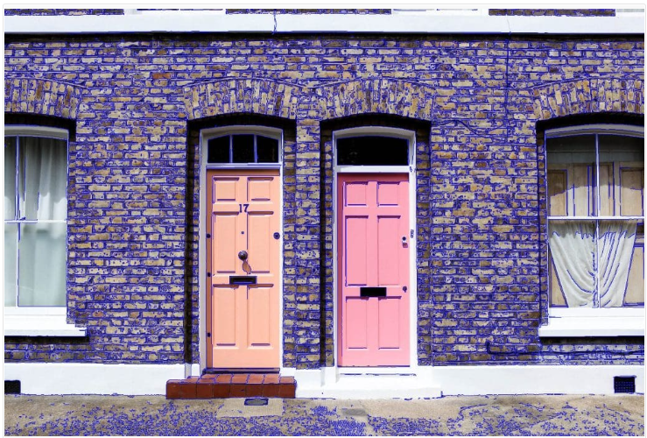
Feature Detection
Canny Edge Detection in OpenCV

Slide 19
Feature Detection
Harris Corner Detection in OpenCV
Harris Corner Detection is a method used to identify significant variations in intensity, which often correspond to the corners of objects in an image. OpenCV offers a simple and efficient implementation of this technique, allowing us to detect corners that serve as prominent features for image analysis and matching.
cv2.cornerHarris(image, blockSize, ksize, k) and get a score for every pixel
The argument to cornerHarris() function include the neighborhood size blockSize and a kernel size ksize. Both are small positive integers but the latter must be an odd number. The final argument k is a positive floating point value that controls the sensitivity of corner detection. Too large such a value will make the algorithm mistake a corner as an edge.

Slide 20
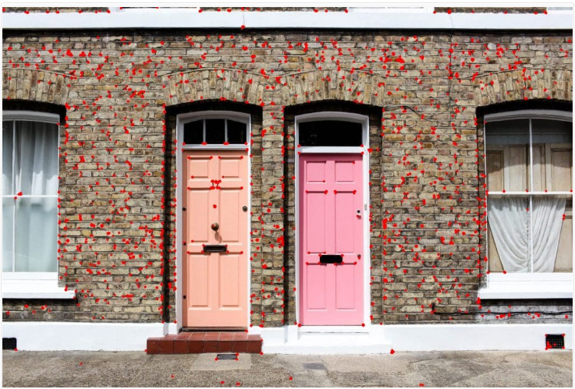
Feature Detection
Harris Corner Detection in OpenCV

Slide 21
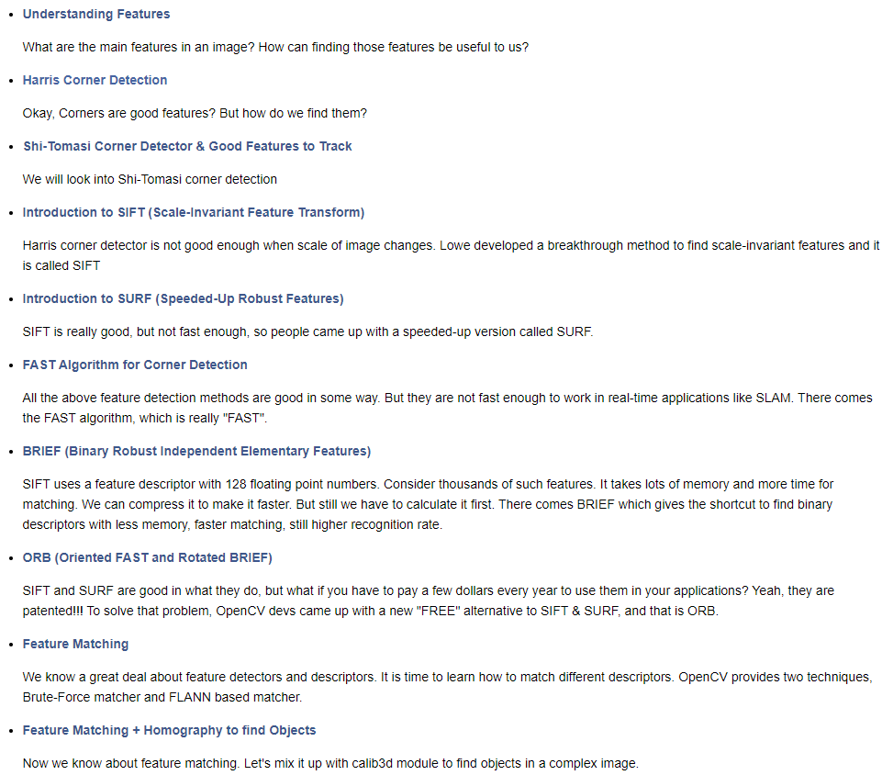
Feature Detection
The features edges and corners from Canny Edge Detection in OpenCV and Harris Corner Detection are extracted in the form of classifying pixels. There are other feature extraction algorithms that can tell us about the image more concisely and extract keypoints in an image.
https://docs.opencv.org/4.x/db/d27/tutorial_py_table_of_contents_feature2d.html

Slide 22
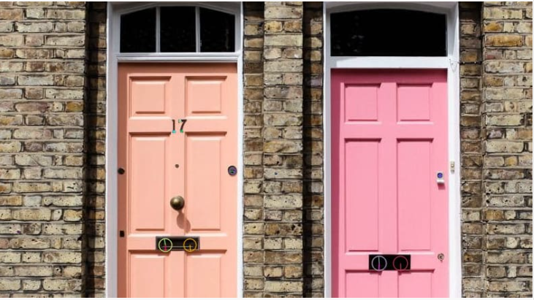
Feature Detection
Keypoint Detection with SIFT and SURF in OpenCV
Scale-Invariant Feature Transform (SIFT) and Speeded-Up Robust Features (SURF) are powerful algorithms for detecting and describing local features in images. They are named scale-invariant and robust because, compared to Harris Corner Detection, for example, its result is expectable even after some change to the image.
The SIFT algorithm derives certain “orientation” values for each keypoint and outputs a vector representing the histogram of the orientation values.
It is found quite slow to run SIFT algorithm. Hence, there is a speed-up version, SURF.
Keypoints detected by the SIFT algorithm
Here we can see the keypoints drawn as circles proportional to its “size” with a stroke indicating the orientation. There are keypoints on the number “17” on the door as well as on the mail slots.

Slide 23
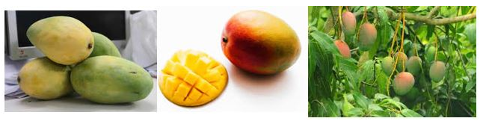
Feature Detection
SIFT is used to detect corners, blobs, circles, and so on.
Consider these three images. Though they differ in color, rotation, and angle, you know that these are the three different images of mangoes. How can a computer be able to identify this?
Both Harris corner detection and Shi-Tomasi corner detection algorithms fail in this case. But SIFT algorithm plays a vital role here. It can detect features from the image irrespective of its size and orientation.

Slide 24
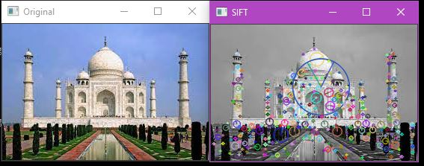
Feature Detection
Scale-Invariant Feature Transform (SIFT)
SURF algorithm is simply an upgraded version of SIFT.

Slide 25
Feature Detection
Histogram of Oriented Gradients (HoG)
Binary Robust Independent Elementary Features (BRIEF)
Oriented FAST and Rotated BRIEF (ORB)
SIFT and SURF are patented so not free for commercial use, while ORB is free.SIFT and SURF detect more features then ORB, but ORB is faster.
Notes:
Keypoints are points of interest in an image. These points can be automatically detected (defined) by the system using algorithms such as SIFT, SURF, and ORB. Some of these algorithms can also define the descriptors to make key points really useful for image processing tasks.

Slide 26
Feature Matching

Slide 27
Feature Matching
The idea of feature matching is the following: we start with a train image and ask our algorithm (which we have to pick in advance) to find some keypoints, which are the indicators of the location of each feature.
Furthermore, the algorithm will also look for descriptors associated with keypoints, which are arrays of numbers which describe the corresponding feature.
So, each feature will have an associated couple of values, (keypoint, descriptor).
Then we repeat the same procedure with the query image (that where we want to look for similarities).
Finally, we look for similar descriptors between the two images, which will indicate the presence of a match among features.

Slide 28
Image Similarity
In a world with images, the ability to measure and quantify the similarity between images has become a critical task. Whether it’s for image retrieval, content recommendation, or visual search, image similarity approaches play a pivotal role in modern applications.
Image similarity can be thought of as a numerical representation of how alike two images are in terms of their visual content. There are several dimensions along which images can be similar, such as color, shape, texture, and composition. Various mathematical and computational methods are employed to quantify these similarities, enabling us to compare and categorize images efficiently.

Slide 29

Image Similarity Approaches
Histogram-Based Approaches
Histograms capture the distribution of pixel values in an image. By comparing the histograms of two images, you can measure their similarity.
The Histogram Intersection and Histogram Correlation metrics are commonly used for this purpose. Python’s OpenCV library provides tools to compute and compare histograms.
Mean Squared Error (MSE)
Mean Squared Error (MSE) is a simple and widely used method to compare two images. It calculates the average squared difference between the two images' pixel values. The lower the MSE value, the more similar the images are.

Slide 30
Image Similarity Approaches
Feature-Based Approaches
These methods extract salient features from images, such as edges, corners, or key points. Techniques like Scale-Invariant Feature Transform (SIFT) and Speeded-Up Robust Features (SURF) identify distinctive points in images, which can then be compared across images.
Structural Similarity Index (SSIM)
SSIM is a widely used metric that assesses the structural similarity between two images.
It considers luminance, contrast, and structure, giving a score between -1 (dissimilar) and 1 (identical).
The main drawback of the SSIM approach compared to the Histogram approach is that the images have to be the same dimension.

Slide 31
Image Similarity Approaches
Structural Similarity Index (SSIM)
https://www.mathworks.com/help/images/ref/ssim.html
Most Image quality assessment techniques rely on quantifying errors between a reference and a sample image. A common metric is to quantify the difference in the values of each of the corresponding pixels between the sample and the reference images (By using, for example, Mean Squared Error).
The Human visual perception system is highly capable of identifying structural information from a scene and hence identifying the differences between the information extracted from a reference and a sample scene. Hence, a metric that replicates this behavior will perform better on tasks that involve differentiating between a sample and a reference image.
The Structural Similarity Index (SSIM) metric extracts 3 key features from an image:
Luminance
Contrast
Structure
The comparison between the two images is performed on the basis of these 3 features.
This system calculates the Structural Similarity Index between 2 given images which is a value between -1 and +1. A value of +1 indicates that the 2 given images are very similar or the same while a value of -1 indicates the 2 given images are very different.

Slide 32
Disclaimer
Due to nature of the course, various materials have compiled from different open source resources with some moderation. I sincerely acknowledge their hard work and contribution

Slide 33


